Slide 1

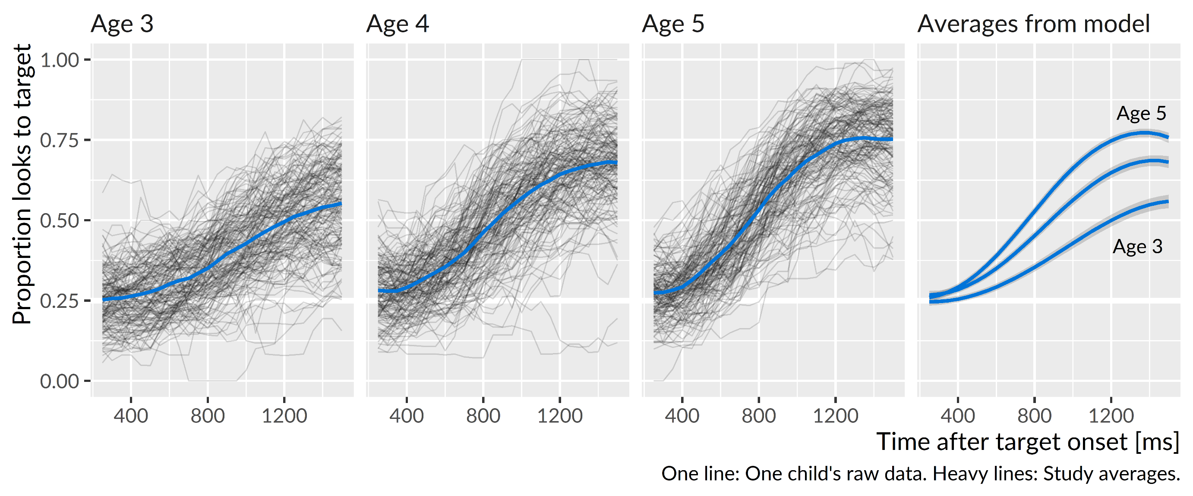
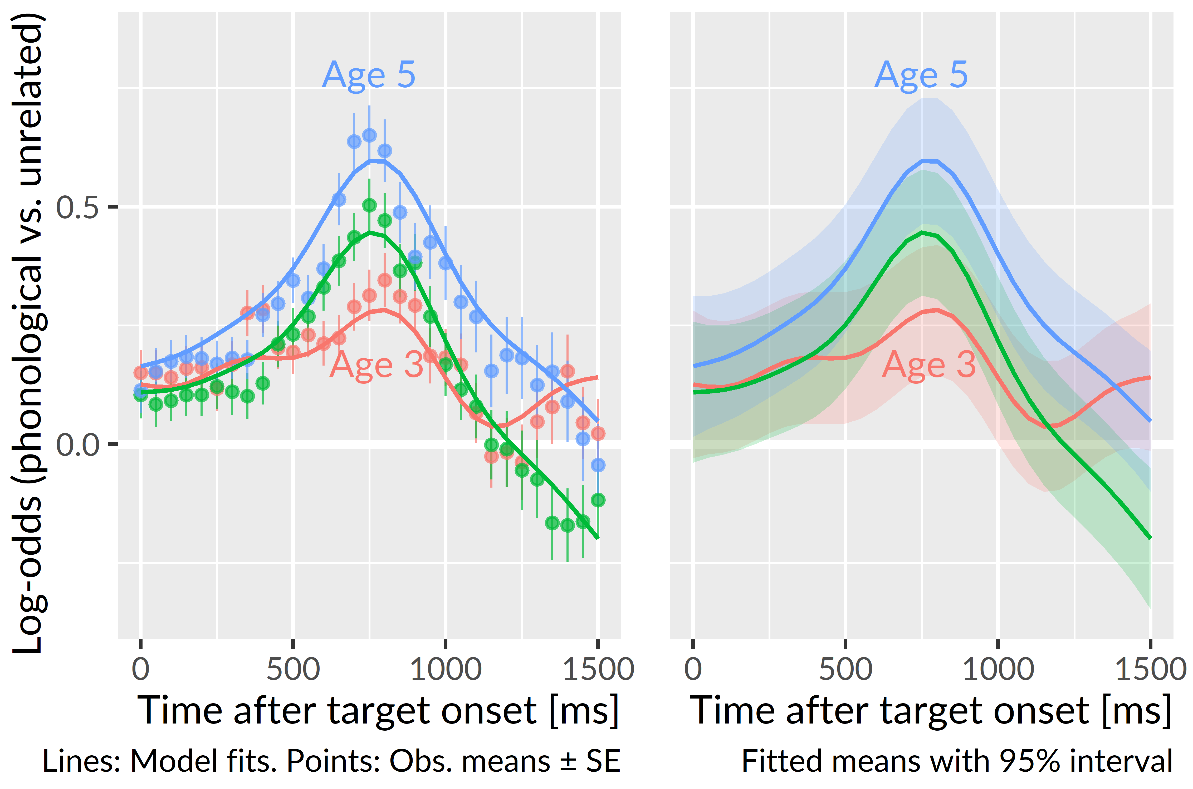
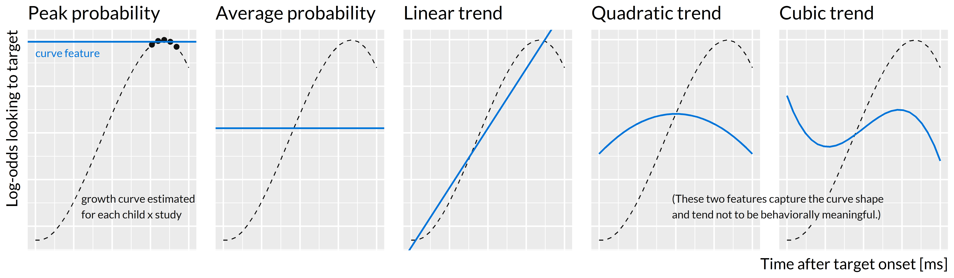
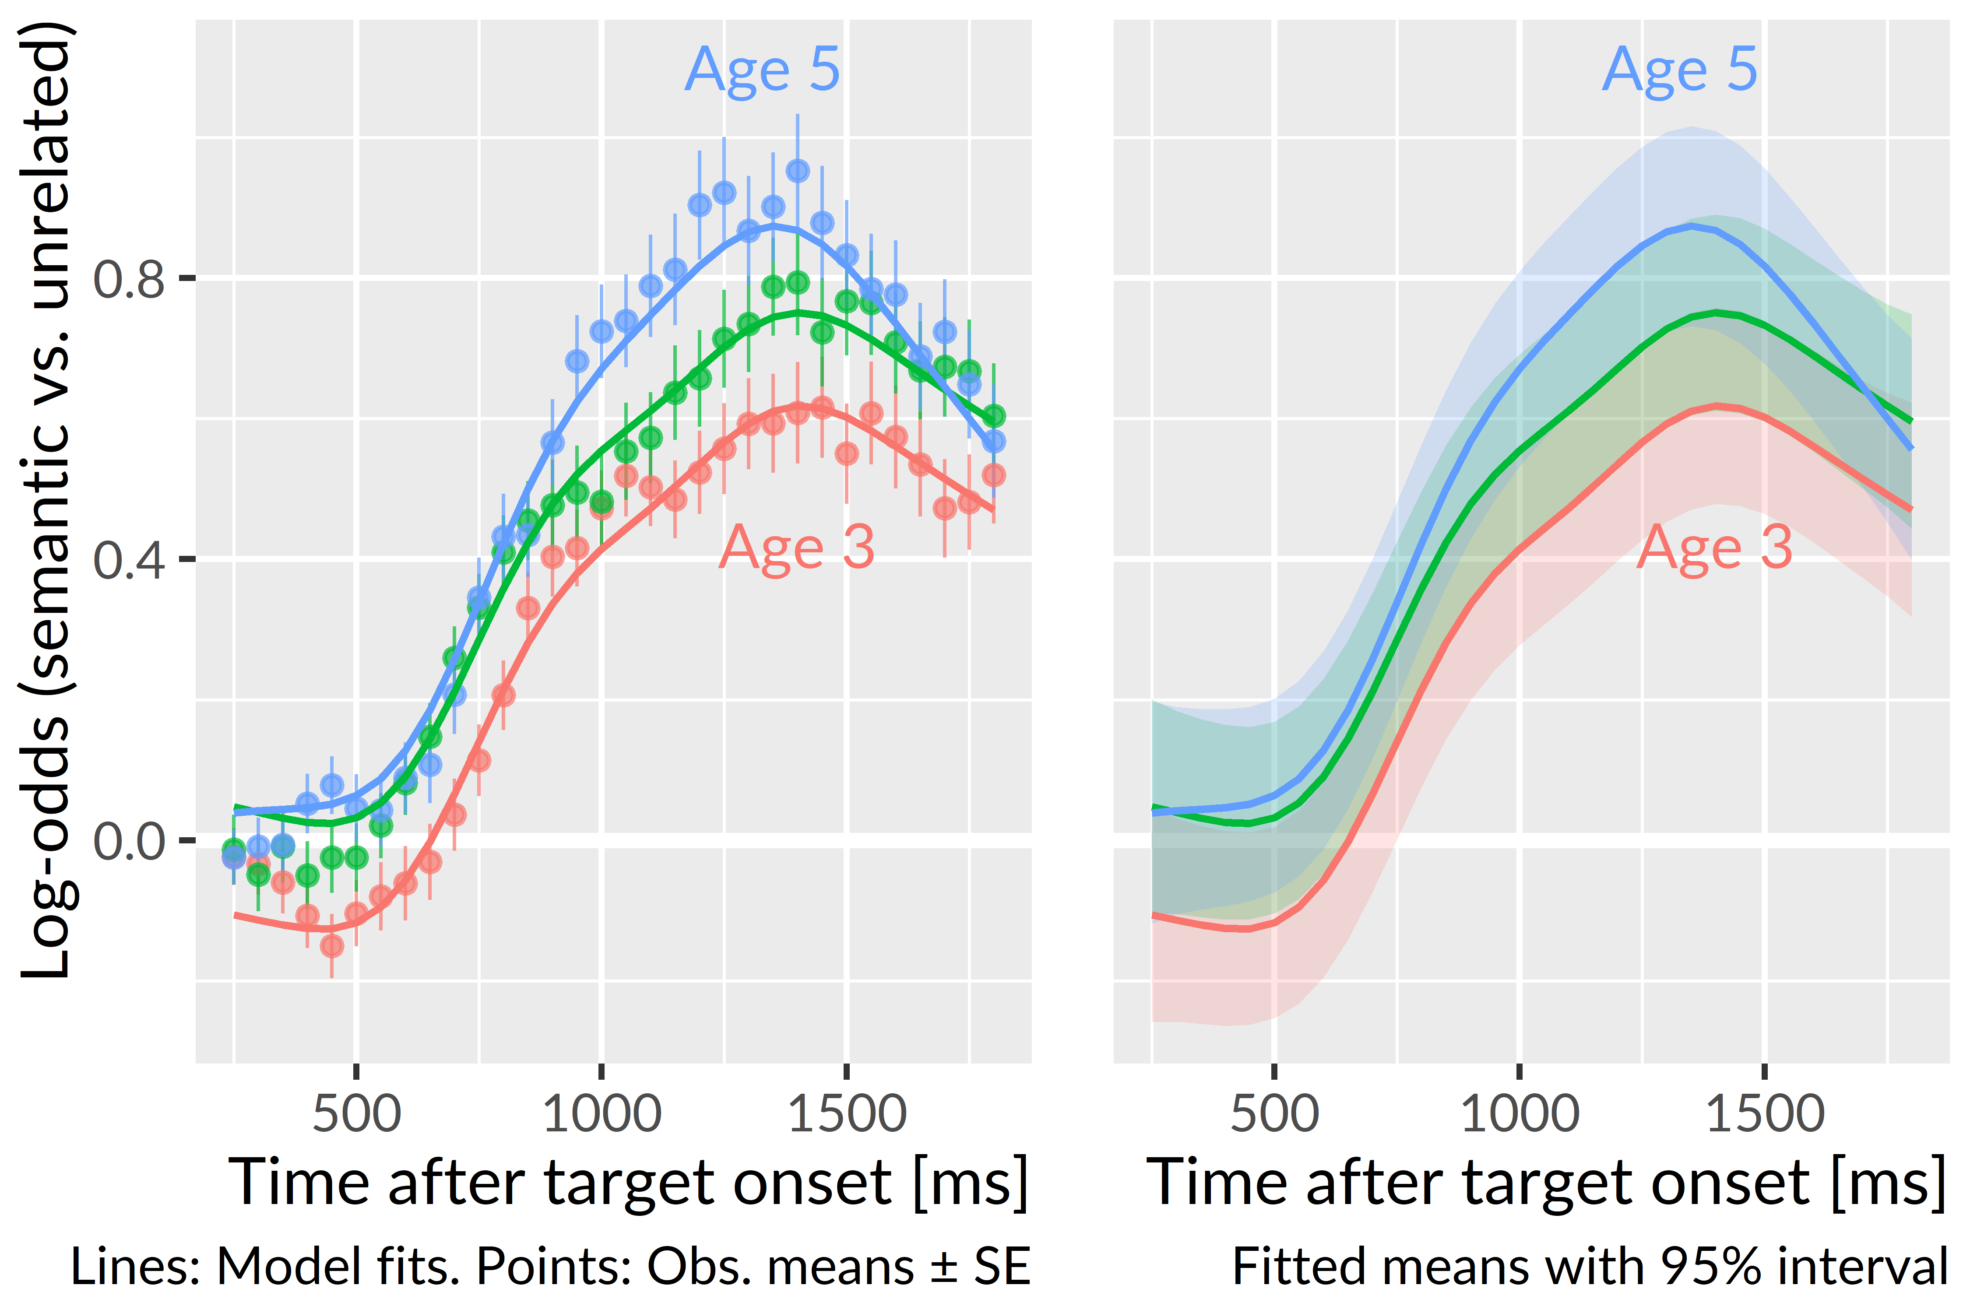
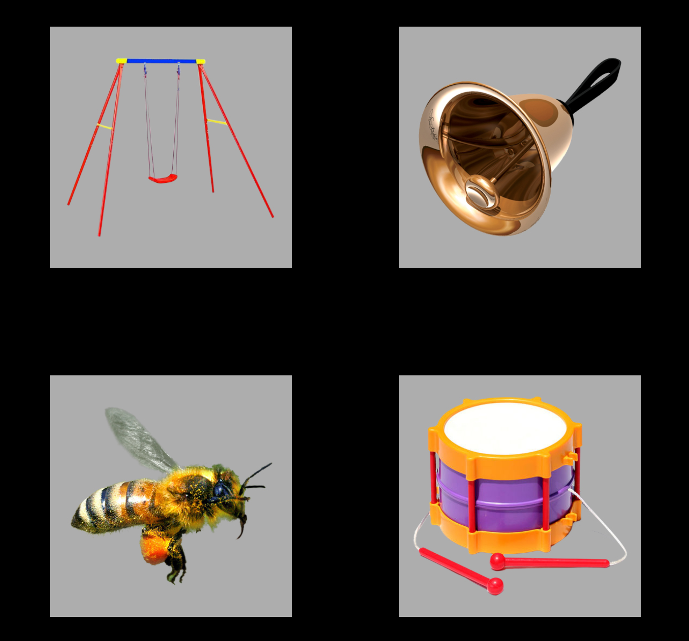
Development of familiar word recognition
in preschoolers
Tristan Mahr, University of Wisconsin–Madison Jan Edwards, University of Maryland
Background
Recent work suggests word recognition efficiency—how well children map incoming speech to words—may help identify early differences in children’s language trajectories
We do not know, however, how word recognition itself develops over time or how individual differences in word recognition change over time.
Current study
How does familiar word recognition develop over the preschool years?
Are individual differences in word recognition stable over developmental time?
How does children’s sensitivity to lexical competitors change with age?
Method
Participants
Data were collected during a three-year longitudinal study.
Procedure
Children heard a familiar word in a carrier phrase (e.g., “find the bell”) and saw an array of photos, including a target, a semantic, a phonological, and an unrelated competitor.
Tobii T60XL eyetracker measured children’s patterns of looking to the images over the course of a trial.
This procedure measures a child’s real-time comprehension of words by capturing how the child’s gaze location changes over time in response to speech.
Growth curve analysis
We estimated a growth curve for each child x year with Bayesian mixed effects logistic regression.
We used growth curve features to measure individual differences in word recognition.
Peak and average probabilities and linear time trends increased with each year of the study: Children became faster and more accurate at recognizing familiar words.
We asked whether individual differences were longitudinally stable. We treated each year as “a judge” which had to rank children on each growth curve feature. We used Kendall’s W to compute the concordance of these rankings.
Children’s rankings using the peak and average probabilities and the linear trend were longitudinally stable. The other features ranked children as well as random numbers.
Looks to competitors
We modeled the ratio of looks to the phonological and semantic competitor versus the unrelated image.
The advantage of a competitor over the unrelated word reveals children’s sensitivity to the competitor.
Children became more sensitive to phonological and semantically related words as they grew older.
Conclusions
Children’s recognition of familiar words improved each year.
Individual differences in word recognition were stable over time, so that relatively fast children at Age 3 remained relatively fast at Age 5.
As children grew older, they were more likely to look to the phonological and semantic competitors, compared to the unrelated word. When children err, they are more likely to err on a lexically relevant word.
Children become more efficient at recognizing familiar words by becoming more efficient at activating the target word and related words.
Immediate activation of phonological information. Phonological competitors had the same syllable onset as the target (e.g., flag-fly, bell-bee). Relative looks to the phonological competitors spike early on, a tendency that increases with age: Children became more likely to use part-word information during word recognition.
Late activation of semantic information. Semantic competitors belonged to the same category as the target (e.g., bell-drum, bear-horse). Relative looks to these words peak later on (well after the end of the target noun). This timing suggests cascading activation from the target noun. These words peak only after activation of the target has peaked.
Time Point | Children | Age (months) Mean ± SD | Age (months) Range | EVT-2 standard Mean ± SD
Age 3 | 149 | 33 ± 3.5 | 38–39 | 113 ± 18
Age 4 | 162 | 45 ± 3.5 | 39–52 | 118 ± 16
Age 5 | 153 | 57 ± 3.7 | 51–66 | 118 ± 15
“Find the bell!”
Unrelated competitor
(swing)
Target noun
(bell)
Phonological competitor
(bee)
Semantic competitor
(drum)
The authors have no financial or non-financial conflicts of interest.
Funding provided by R01 DC002932, R01 DC012513, T32 DC05359, and U54 HD090256.
Symposium on Research in Child Language Disorders
Madison, WI: June, 2018
Contact: Tristan Mahr (tristan.mahr@wisc.edu)

